Slide 1
City of Antioch
Public Meeting for the
Brackish Water Desalination Project Draft EIR
August 1, 2018, 6:30 PM

Slide 2
Overview
Project Background and Objectives
Project Overview
CEQA Process
Environmental Impact Analysis
Next Steps
Public Comments
Notes:
Scott B

Slide 3
Project Background
City has two sources of drinking water:
San Joaquin River
Pre-1914 water rights with permitted intake of 16 mgd
Contra Costa Water District (CCWD)
Challenges:
Limited operational flexibility and reliability of supply during droughts.
Limited water supply diversification
Use of River water is limited by River’s water quality
Continued reliance on CCWD water
Notes:
Scott B

Slide 4
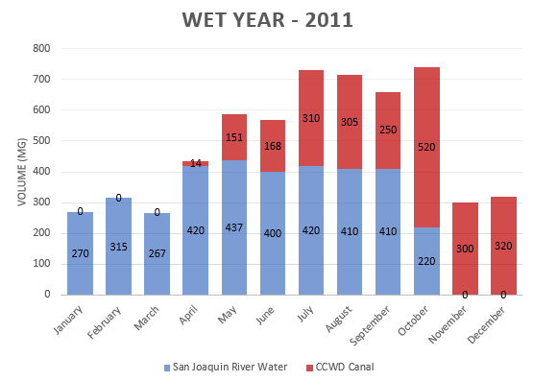
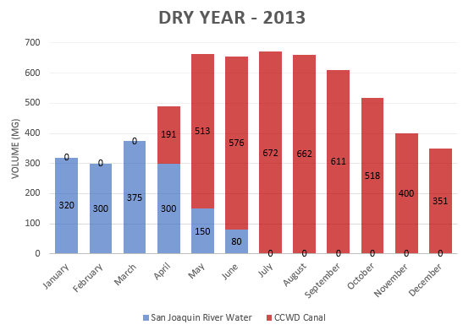
Project Background
In wet years, 40% of the City’s supply comes from the San Joaquin River
In dry years, the City must switch to CCWD supply earlier. As little as 25% of the City’s supply may come from the San Joaquin River
Notes:
Scott B

Slide 5
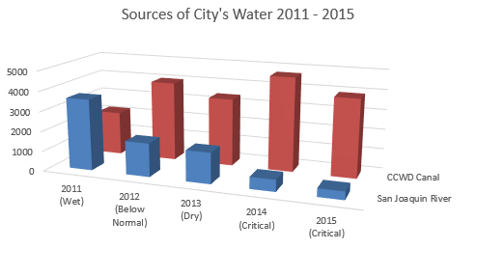
Project Background
Notes:
Scott B
This illustrates actual water use during the recent drought

Slide 6
Project Objectives
Improve water supply reliability and water quality
Develop a reliable, and drought-resistant water source to reduce dependency on purchased water supplies by maximizing the use of the City’s pre-1914 water rights.
Maximize the use of existing infrastructure to maintain economic feasibility.
Provide cost effective operational flexibility to allow the City to respond to changes in source water quality, emergencies, changes in climate and Delta conditions.
Preserve the use and value of the City's pre-1914 water rights.
Notes:
Scott B

Slide 7
Project Overview
Key Project Components
Replace San Joaquin River Intake Pump Station and fish screen
Construct 6 mgd desalination facility and appurtenant facilities at the existing Antioch WTP
New pipeline to directly connect Antioch WTP to existing raw water pipeline
New pipeline for brine disposal
Notes:
Scott B

Slide 8
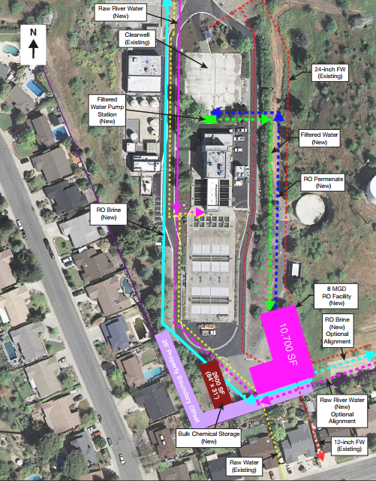
Conceptual Site Plan
Notes:
Scott B

Slide 9
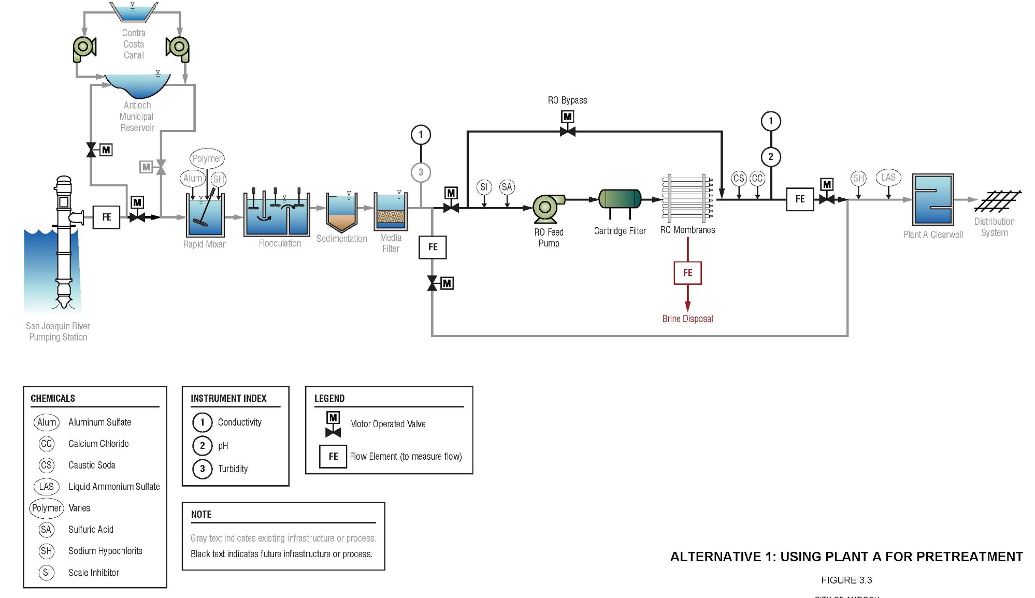
Desalination Process
Notes:
Scott B

Slide 10
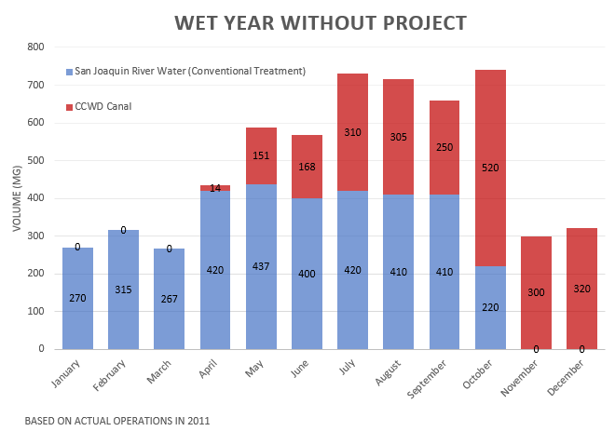
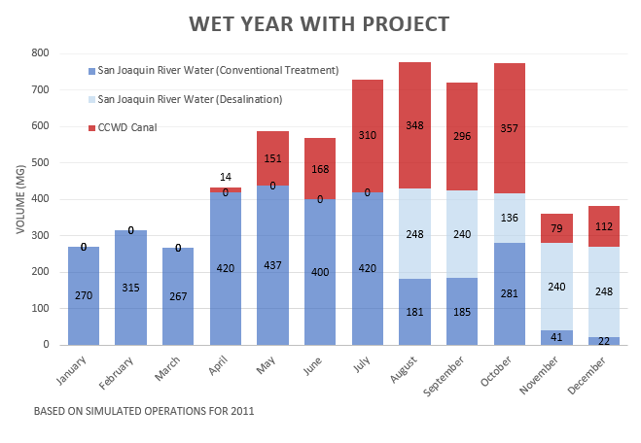
Wet Year Operations – Raw Water Use
Notes:
Scott B
Note from Sam: When you present the slides on representative wet and dry year use, I suggest emphasizing that while you are showing representative wet and dry years to illustrate how the project could operate, operations were analyzed over a full range of hydrologic conditions (water year types) for the EIR. (don’t need a new slide, can just make the point verbally and refer to the relevant parts of EIR)

Slide 11
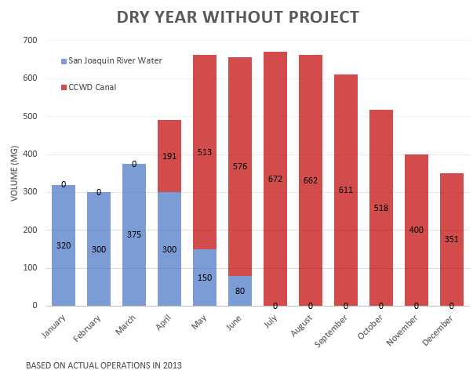
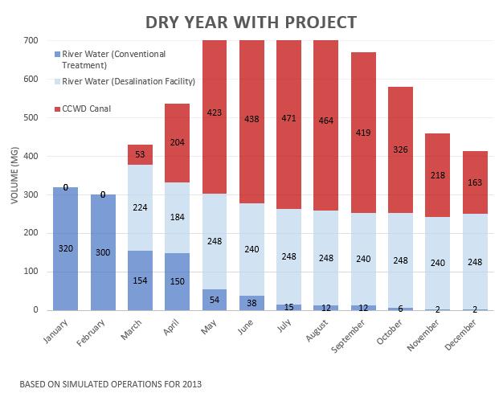
Dry Year Operations – Raw Water Use
Notes:
Scott B

Slide 12
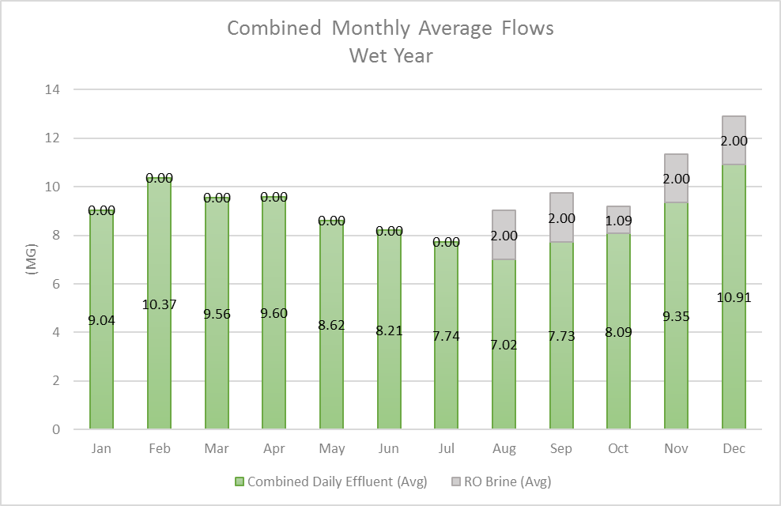
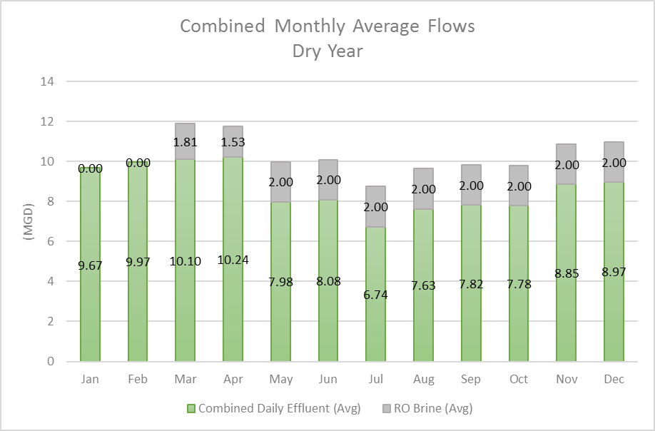
Operations – Brine Disposal
Notes:
Scott B

Slide 13
California Environmental Quality Act (CEQA)
Purpose of CEQA and the EIR
INFORM decision-makers and public of the project’s potential environmental effects
ENGAGE the public in environmental review process
DISCLOSE potential project impacts on the environment
AVOID and/or REDUCE potential impacts of the projects with alternatives and/or mitigation measures
Notes:
ESA

Slide 14
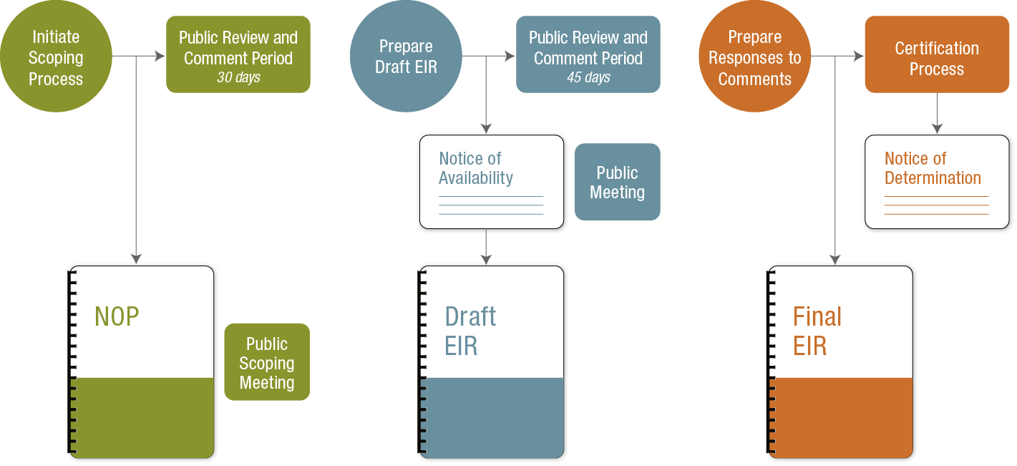
CEQA Process
NOP Circulated: 8-15-2017
Through 9-14-2017
Draft EIR Circulated: 6-29-2018
Review Period Closes: 8-13-2018
Anticipated: Early Fall 2018
Notes:
ESA

Slide 15
Resource Topic Analysis in EIR
Aesthetics
Air Quality
Aquatic Biological Resources
Terrestrial Biological Resources
Cultural Resources
Geology, Soils, and Paleontological Resources
Greenhouse Gas Emissions
Energy Conservation
Hazards and Hazardous Materials
Local Hydrology and Water Quality
Delta Hydrology and Water Quality
Land Use and Planning
Noise and Vibration
Population and Housing
Public Services and Utilities
Recreation
Utilities and Service Systems
Transportation and Circulation
Tribal Cultural Resources
Notes:
ESA

Slide 16
Levels of Environmental Impact
No Impact
Less than Significant
Less than Significant with Mitigation Measure(s)
Significant and Unavoidable Impacts
Notes:
ESA

Slide 17
Less than Significant Impact / No Impact
Effects found not to be significant:
Aesthetics
Geology, Soils, and Paleontological Resources
Greenhouse Gases
Local Hydrology and Water Quality
Delta Hydrology and Water Quality
Land Use and Planning
Population and Housing
Notes:
ESA

Slide 18
Potentially Significant Impacts – Mitigated to Less than Significant
Air Quality
Impacts: Temporary construction emissions
Mitigation measures rely on Bay Area Air Quality Management District (BAAQMD) Construction Measures, use of less polluting engines
Aquatic Biological Resources
Impacts: Construction impacts on aquatic habitat and species.
Mitigation measures for worker training, seasonal avoidance, fish rescue plan, underwater construction measures, mitigation requirements from permits.
Notes:
ESA

Slide 19
Potentially Significant Impacts – Mitigated to Less than Significant
Terrestrial Biological Resources
Impacts: Construction impacts on terrestrial species and habitat
Mitigation measures for pre-construction surveys and restoration/revegetation.
Cultural Resources, Tribal Cultural Resources
Impacts: Discovery of unknown resources
Mitigation measures and protocol in the event of inadvertent discovery during construction.
Notes:
ESA

Slide 20
Potentially Significant Impacts – Mitigated to Less than Significant
Energy Conservation
Impacts: Energy use during construction and decommissioning activities
Mitigation measures rely on BAAQMD Construction Measures and identifying measure to increase efficient use of construction equipment
Hazards and Hazardous Materials
Impacts: Use of hazardous materials, encountering active or abandoned pipelines with petroleum product
Mitigation measures include construction traffic management plan, health and safety plan, soil management plan, and ACM management plan
Notes:
ESA

Slide 21
Potentially Significant Impacts – Mitigated to Less than Significant
Noise and Vibration
Impacts: Temporary construction impacts, operational noise
Mitigation measures include noise controls for construction equipment and activity, stationary-source noise controls for desalination plant operation
Public Services and Utilities
Impacts: Underground utilities
Mitigation measures include confirming overhead and underground utility lines, safety measures for workers, emergency response plan, notify and coordinate with affected utilities
Notes:
ESA

Slide 22
Potentially Significant Impacts – Mitigated to Less than Significant
Recreation
Impacts: Temporary disruption of recreational resources
Mitigation measure includes construction traffic management plan which requires notification of affected users and measures to provide continued or alternate access
Transportation and Circulation
Impacts: Temporary construction impacts
Mitigation measure includes obtaining encroachment permits, and a Construction Traffic Control/Traffic Management Plan
Notes:
ESA

Slide 23
Submit a Public Comment
Comment Period: June 29 – August 13, 2018, 5:00 p.m.
Orally: At This Meeting
Fill out speaker card to speak (3 minute limit)
In Writing:
Mail or Email Written Comments Directly to:
Scott Buenting, Project Manager
City of Antioch
200 H Street
Antioch, CA 94509
Sbuenting@ci.antioch.ca.us
Comments due by 5:00 p.m., August 13, 2018
Notes:
ESA

Slide 24
Public Comments

